Slide 1
Carl Zeiss Meditec Stock Price Data Analysis
Utilizing Quandl API

Slide 2
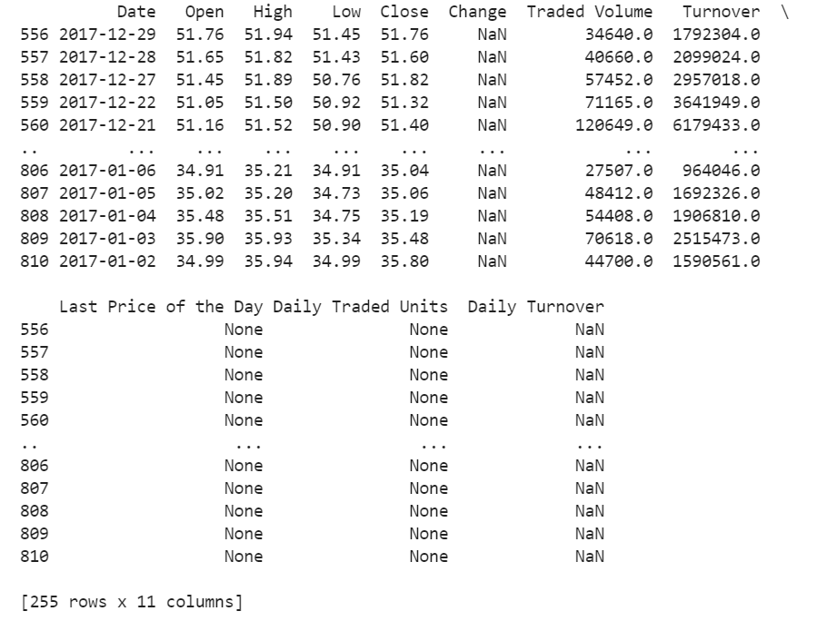
Data Wrangling with Quandl API
Using requests and JSON tools, Quandl API was accessed
In the Frankfurt Stock Exchange (FSE), company Carl Zeiss Meditec was analyzed
Dataset was filtered for by date
2017

Slide 3
Technical Results derived from Price and Volume
The highest price for this stock: 53.54
The lowest price for this stock: 33.62
The largest change in one day based on the highs & lows: 2.81
The largest change of two days based on the highs & lows: 3.75
The mean for 2017 daily trading volume: 89124
The median for 2017 daily trading volume: 76286

